Slide 1

Welcome
Logipool Infotech Pvt. Ltd

Slide 2
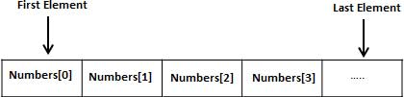
Array
Arrays are structures that hold multiple variables of the same data type. The first element in the array is numbered 0,
so the last element is 1 less than the size of the array. An array is also known as a subscripted variable.

Slide 3
Declaring Arrays
To declare an array in C, a programmer specifies the type of the elements and the number of elements required by an array as follows −
type arrayName [ arraySize ];

Slide 4
This is called a single-dimensional array. The arraySize must be an integer constant greater than zero and type can be any valid C data type.
double balance[10];
Here balance is a variable array which is sufficient to hold up to 10 double numbers.

Slide 5
Initializing Arrays
You can initialize an array in C either one by one or using a single statement as follows −
double balance[5] = {1000.0, 2.0, 3.4, 7.0, 50.0};
The number of values between braces { } cannot be larger than the number of elements that we declare for the array between square brackets [ ].

Slide 6
If you omit the size of the array, an array just big enough to hold the initialization is created. Therefore, if you write −
double balance[] = {1000.0, 2.0, 3.4, 7.0, 50.0};
You will create exactly the same array as you did in the previous example. Following is an example to assign a single element of the array
balance[4] = 50.0;

Slide 7
Accessing Array Elements
An element is accessed by indexing the array name. This is done by placing the index of the element within square brackets after the name of the array. For example −
double salary = balance[9];

Slide 8
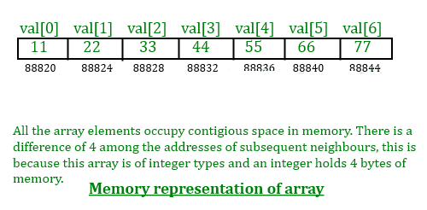
C Array – Memory representation

Slide 9
Multidimensional arrays
The simplest form of multidimensional array is the two-dimensional array.
A two-dimensional array is, in essence, a list of one-dimensional arrays. T
o declare a two-dimensional integer array of size [x][y]

Slide 10
type arrayName [x][y];
Multidimensional arrays may be initialized by specifying bracketed values for each row. Following is an array with 3 rows and each row has 4 columns.
int a[3][4] = { {0, 1, 2, 3} , /* initializers for row indexed by 0 */ {4, 5, 6, 7} , /* initializers for row indexed by 1 */ {8, 9, 10, 11} }; /* initializers for row indexed by 2 */

Slide 11
The nested braces, which indicate the intended row, are optional. The following initialization is equivalent to the previous example −
int a[3][4] = {0,1,2,3,4,5,6,7,8,9,10,11};

Slide 12
Thank You

